Slide 2
Gradient Descent

Slide 3
Previously learned that machine learning is trying to minimize an objective function:
Logistic Regression Loss: J(w)=∑y(i)log P(y(i)=1|w)+(1−y(i))log P(y(i)=0|w) where P(y(i)=1|w) = 1 / (1 + e^{-wx})
How to find that minima efficiently?
Exhaustive search?
Random guess?
Gradient Descent!
Iteratively follow the ∇J(w) in the direction of steepest descent till you hit the bottom.
wikipedia.org

Slide 4
The Algorithm
For a defined differentiable scalar function J(w), (w is a vector of values), travel the gradient vector field as follows:
Pick some “reasonable” starting point: w₀
while ||w_{i} - w_{i-1}||> ε and ||∇J(w_{i})|| > ε:
w_{i+1} = w_{i} - α_{i}∇J(w_{i})
Wikipedia.org (original image)

Slide 5
Picking Step Sizes
Step sizes depend on α_{i}
Too small and you’ll take forever to find the minima
Too large and you’ll constantly overshoot it.

Slide 6
Learn the learning rate
Add a scaling factor to the step size term so subsequent steps get smaller as you reach the bottom of the gradient.
while ||w_{i} - w_{i-1} ||> ε and || ∇J(w_{i})|| > ε:
If J(w_{i} - α_{i}∇J(w_{i})) > J(w_{i}) - a_{i}/2 ||∇J(w_{i})||²:
α_{i =} β α_{i-1}
Else
α_{i =} β α_{i-1}
w_{i+1} = w_{i} - α_{i}∇J(w_{i})

Slide 7
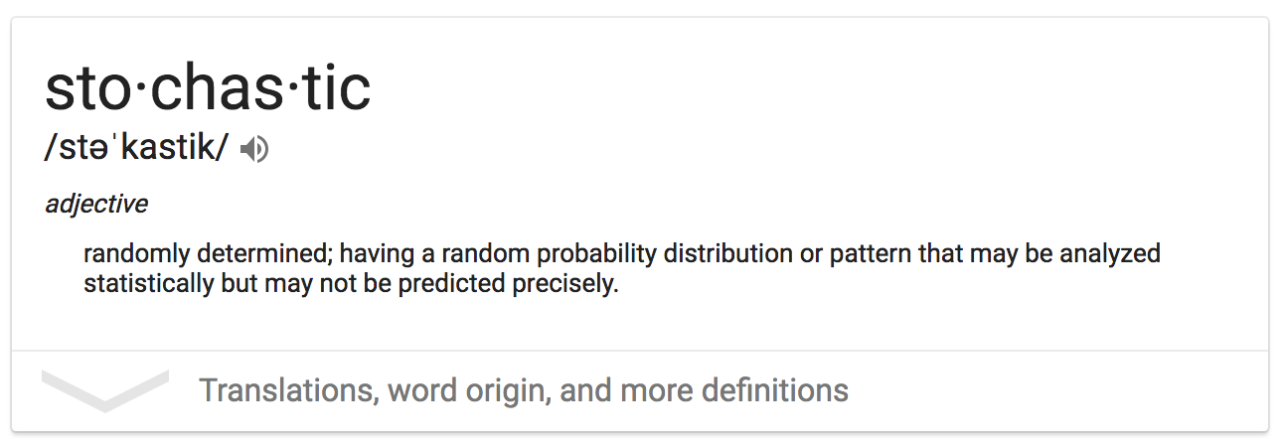
Stochastic Gradient Descent & Mini-Batch

Slide 8
Approximation Method
Stochastic Gradient Descent
Rather than measure the Loss on the entire dataset, estimate it with a single example for each iteration.
Sounds crazy!
But it works, because each example is an unbiased estimate of the total error.
Mini-batch
For each iteration, measure the loss on a randomly chosen subset of the dataset
Reduces the variance w.r.t stochastic gradient descent
These approaches allow you to scale gradient descent to arbitrarily large datasets with arbitrarily large numbers of features.

